Slide 1
Post-Doctoral Researcher
Subduction within mantle convection: fate and reference frames
> Entity/Service :
Type of Recruitment: Contractual (2-year fixed-term contract)
Category: Post-Doctoral Researcher
Working Hours: Full-time
Location: UMR Géoazur , Campus Azur du CNRS 250 rue Albert Einstein
- CS 10269 - F 06905 SOPHIA ANTIPOLIS Cedex
Reference Number:
The challenge
You have experience in geodynamic modeling of convection in the mantle. We are looking for a postdoctoral researcher to join the ERC Pandora project team and work in collaboration with Karin Sigloch (Oxford University). Your work will involve the detailed analysis and design of spherical 3D convection models. The objective is to characterize subduction from its initiation to its fate into the mantle, in order to understand the links between subduction mechanics, its tomographic signature at depth, and its kinematics relative to different reference frames.
Join us at Université Côte d’Azur, recognized since 2016 for its scientific and educational excellence, to create together the model of a responsible and innovative 21st-century university.
Your missions
Mission 1: Analyze an existing model using digital tools developed by the Pandora team.
Mission 2: Compare the results with tomographic models.
Mission 3: Design convection models to identify key parameters that will improve the reference model.
This job is for you if i
You have significant experience in geodynamics.
You are proficient in advanced programming tools.
You have a strong understanding of the physics of convection and plate tectonics.

Slide 2
Your professional background
Degree/experience
Compensation and benefits
Contractual remuneration (excluding variable compensation): XXXX gross per month or from XXXX gross per month depending on your profile
Vacation: 45 days annual leave
Telework: XX days/week
Partial reimbursement of commuting expenses
Partial coverage of supplementary medical insurance fees
Access to CROUS university restaurants and cafeterias at special rates
Tickets for entertainment and outings at preferential rates
The work environment
The Géoazur Lab is a multi-disciplinary joint research unit made up of geophysicists, geologists and astronomers working together on major scientific issues: natural hazards and risks (earthquakes, landslides, tsunamis, floods) and man-made risks (man-made earthquakes and vibrations, pollution, human behaviour, vulnerability of territories and structures), the dynamics of the earth and planets, the geosciences of marine environments (from digital and instrumental innovation to applications), and geodesy and space metrology.
How to apply
Interested in this ad? Don't hesitate! Apply now by email to: Marina.MOLINO-LOVA@univ-cotedazur.fr
Your application should include a CV and cover letter, which we will read carefully.
Recruitment calendar:
Deadline for receipt of applications: 31/12/2025
From 31/12/2025: Responses to applications, shortlisting and organizing interviews
Desired start date:
February 2026

Slide 3
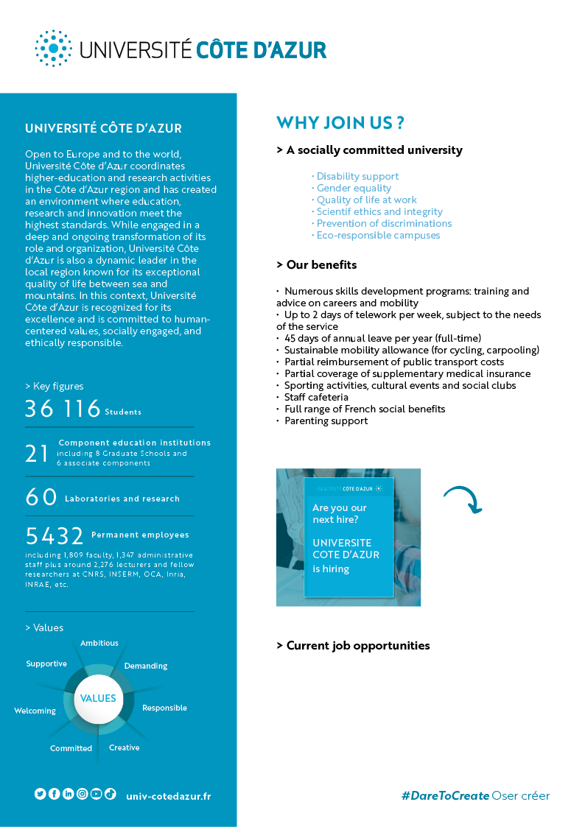
10 good reasons to join us
All our job offers are available on the web Working at Université Côte d'Azur
All our positions are open to people with disabilities

